Slide 1

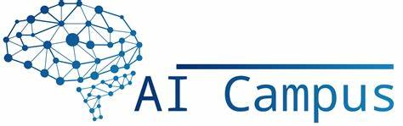
Brain-Imaging: Classification of Brain Tumor using CNN with MRI Data In Collaboration with Cedar’s Sinai Advisor Dr. Jack Han, Committee members: Dr. Mohsen Beheshti, Dr. Jonathan Stubblefield
By
Sumanth Soora[Grp-4]
Graduate Student
12/08/2023

Slide 2

Introduction
Introduction to Brain Imaging: Brain imaging is a fundamental tool in modern medicine, offering a window into the complex structures and activities of the brain. It's crucial for diagnosing a range of neurological conditions, from injuries to diseases
Significance of MRI: MRI provides high-resolution images of brain tissues, making it invaluable in diagnosing and monitoring brain disorders, including tumors
Difficulties in Accurate Classification of Brain Tumors:
1. Challenges in Diagnosis
2. Impact of Misclassification
3. Automation Need

Slide 3

Objectives
Developing a CNN Model for Accurate Classification:
Objective: The primary objective is to develop a Convolutional Neural Network (CNN) model capable of accurately classifying different types of brain tumors from MRI images.
Focus on Precision: Emphasize the need for high precision in the classification process,
Enhancing Diagnostic Efficiency and Accuracy:
Automated Image Analysis: Implementing automated image analysis techniques to assist and possibly expedite the diagnostic process.
Supporting Medical Professionals: The goal is not just to automate but to provide a reliable tool that can assist radiologists and medical professionals in making more informed decisions

Slide 4
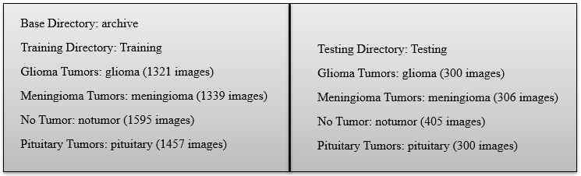
Data Set Overview
Source and Composition:
Source: By “Kaggle”
Types of Brain Tumors: glioma, meningioma, No tumor and pituitary tumors.
Image Count and Diversity:
Data Characteristics:
Image Formats and Resolution: JPEG and 512x512

Slide 5
Data Preprocessing
Preprocessing Step:
Resizing
Normalization
Data Augmentation
One hot encoding
Why These Steps are Crucial for CNN Analysis:
Ensuring Input Consistency
Combatting Overfitting and Enhancing Robustness
Aligning Data with Model Architecture

Slide 6
Model Architecture Overview
Convolutional Layers:
Purpose: These layers form the core of the CNN. They apply a number of filters to the input image to create feature maps, capturing essential features like edges, textures, etc
MaxPooling Layers:
Purpose: These layers follow convolutional layers and perform down-sampling by reducing the dimensions of the feature maps.
Flattening:
Purpose: The Flatten layer is used to convert the 2D feature maps into a 1D feature vector, preparing it for the dense layer.
Dense Layers:
Purpose: These layers are fully connected layers that come after flattening the feature maps. They are used for classification based on the features extracted by the convolutional layers

Slide 7
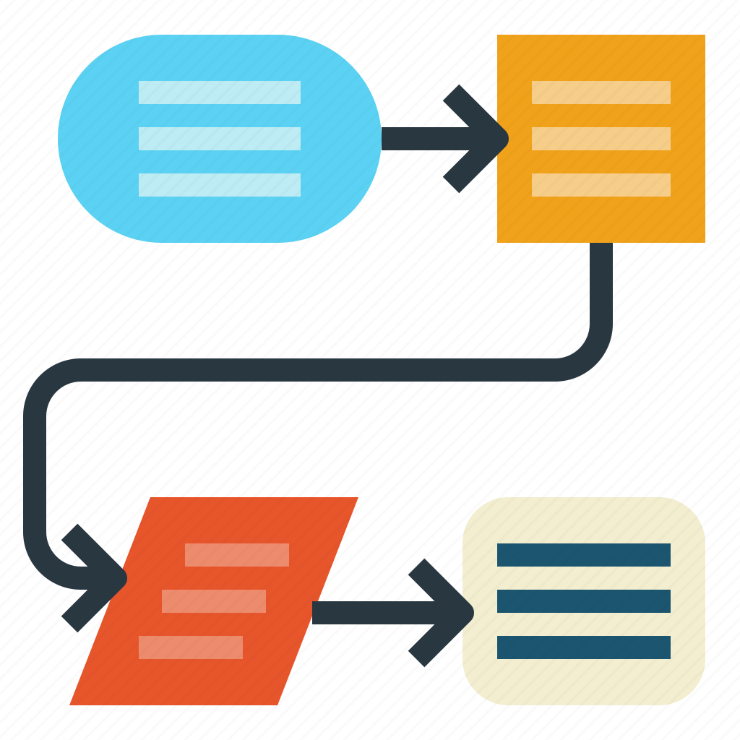
Model Architecture Overview
Dropout:
Purpose: Dropout is a regularization technique used in dense layers.
Activation Functions (ReLU):
Purpose: ReLU (Rectified Linear Unit) is used as the activation function in convolutional layers.
Output Layer (Softmax):
Purpose: The final layer in the CNN with a SoftMax activation function, used for multi-class classification.
Overall Architecture Flow
The model architecture is designed to first extract and learn features from the input images using convolutional and pooling layers, followed by flattening and dense layers that interpret these features for classification. Regularization techniques like Dropout are used to enhance the model's generalization ability.
.

Slide 8











Architecture

Slide 9
Implementation
Environment Setup:
Development Tools: Utilized Python programming language due to its extensive support for data science and machine learning.
Libraries and Frameworks: Leveraged TensorFlow and Keras for their comprehensive neural network libraries and ease of model construction, training, and evaluation.
Model Development:
Architecture Design: Designed a CNN model with multiple convolutional, max-pooling, and dense layers, implementing dropout for regularization.
Parameter Tuning: Adjusted hyperparameters such as the number of filters, kernel size, and learning rate to find the optimal model configuration.

Slide 10
Implementation
Training Process:
Data Preparation: Preprocessed the dataset through resizing, normalization, and augmentation to create a robust training set.
Model Compilation: Compiled the model with adam optimizer and categorical_crossentropy loss function to prepare for training.
Model Fitting: Fitted the model on the training data with validation splits to monitor performance and avoid overfitting using callbacks like EarlyStopping.
Evaluation and Testing:
Validation: Used a separate validation set during training to fine-tune the model and adjust parameters as needed.
Testing: Evaluated the final model on a test dataset to assess its performance and generalization ability.

Slide 11
Experiments and Training
Model Training:
Epochs and Batch Size: The model was trained for a pre-determined number of epochs with a batch size that balances computational efficiency and learning stability.
Monitoring: Utilized callbacks to monitor validation accuracy and loss during training, allowing for dynamic adjustments such as early stopping when the model ceased to show improvement.
Regularization Strategies:
Dropout: Integrated dropout layers to reduce overfitting by randomly deactivating a subset of neurons during training.
Data Augmentation: Enhanced the training data with augmented images to prevent the model from learning noise and irrelevant patterns.

Slide 12
Challenges
Challenges Encountered
Overfitting:
Symptoms: Noticed high training accuracy with poor validation performance, indicative of overfitting.
Solutions: Addressed with the introduction of dropout layers, data augmentation, and early stopping during training.
Class Imbalance:
Symptoms: Some classes were underrepresented, leading to biased predictions towards more frequent classes.
Solutions: Utilized data augmentation to increase the number of samples for underrepresented classes and adjusted class weights during model training to account for imbalances.

Slide 13
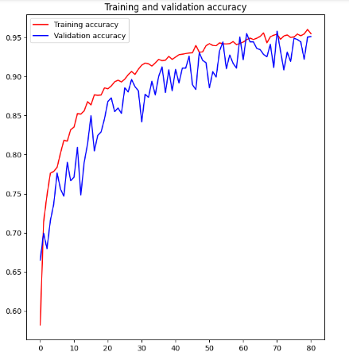
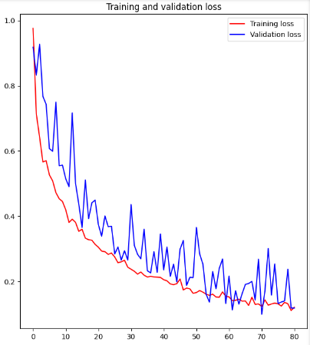
Results
Key Performance Metrics:
Accuracy:
Training Accuracy: 94.43%
Validation Accuracy: 95.80%
Loss:
Training Loss: 12.36%
Validation Loss: 9.94%

Slide 14
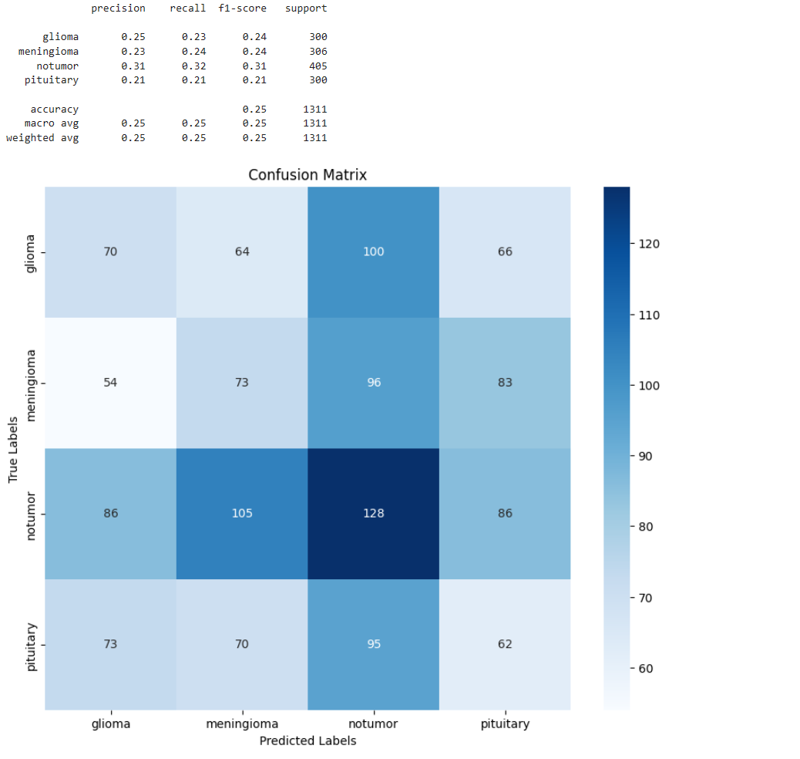
Results
The confusion matrix reveals that the model is best at identifying 'notumor' cases but often confuses between 'glioma' and 'meningioma’. The model requires significant improvements to effectively differentiate between all tumor types.

Slide 15

Result Analysis
Model Performance:
The model shows excellent performance with high accuracy over 95% for both training and validation sets, indicating strong learning and generalization abilities.
Loss Metrics:
Training and validation losses are low, suggesting a good model fit without overfitting.
Key Takeaways:
The model's consistency across training and validation phases suggests it can be reliable in a clinical setting.
The results reflect successful data handling and model architecture choices.

Slide 16
Future Work
Expand Dataset: Include more diverse MRI images to improve model accuracy.
Advanced Models: Evaluate deeper architectures for better feature extraction.
Transfer Learning: Apply pre-trained networks to enhance learning efficiency.
Model Explainability: Develop methods for clear interpretation of model decisions.

Slide 17
Conclusion
Achievements & Impact
Developed a CNN model with a strong performance in classifying brain tumors from MRI images, achieving over 94% accuracy.
Addressed key challenges in medical imaging through innovative data preprocessing and augmentation techniques.
Demonstrated the potential of deep learning in enhancing diagnostic processes and supporting clinical decisions.
Reflection
The project underscores the transformative power of AI in healthcare, showing how advanced algorithms can potentially improve outcomes and efficiency.
While challenges remain, the promising results pave the way for further research and real-world application.

Slide 18
References
Textbooks on Neural Networks and Deep Learning:
Goodfellow, I., Bengio, Y., & Courville, A. (2016). Deep Learning. MIT Press.
Bishop, C. M. (2006). Pattern Recognition and Machine Learning. Springer.
Scholarly Articles on Medical Imaging with CNNs:
Litjens, G., Kooi, T., Bejnordi, B. E., Setio, A. A. A., Ciompi, F., Ghafoorian, M., ... & Sánchez, C. I. (2017). A survey on deep learning in medical image analysis. Medical Image Analysis.
Official Documentation and Tutorials:
TensorFlow Documentation (https://www.tensorflow.org/learn)
Keras Documentation (https://keras.io/guides/)
Research Datasets:
Brain MRI Images for Brain Tumor Detection Dataset on Kaggle (https://www.kaggle.com/navoneel/brain-mri-images-for-brain-tumor-detection)

Slide 19
Thank you

